Slide 1
PROJECT0 rEVATURE
By: Daniel Cadwell

Slide 2
Project 0 – Custom Banking Application
We need to track customer accounts, see individual transactions, see any related financial details such as loan applications they have made to the bank and if these were approved or denied. Accounts should come in single and joint account types, and should require one or two related customers accordingly. We should have a profile set up for the bank user, and security should be set up for the entire org, including your custom objects.
In addition to the above you should have an Apex class which contains methods for the following:
• Check if an account is overdrawn and change the status of the account accordingly.
• Create a new transaction relating to the account.
• Update the account based on all related transactions to show current balance.

Slide 3



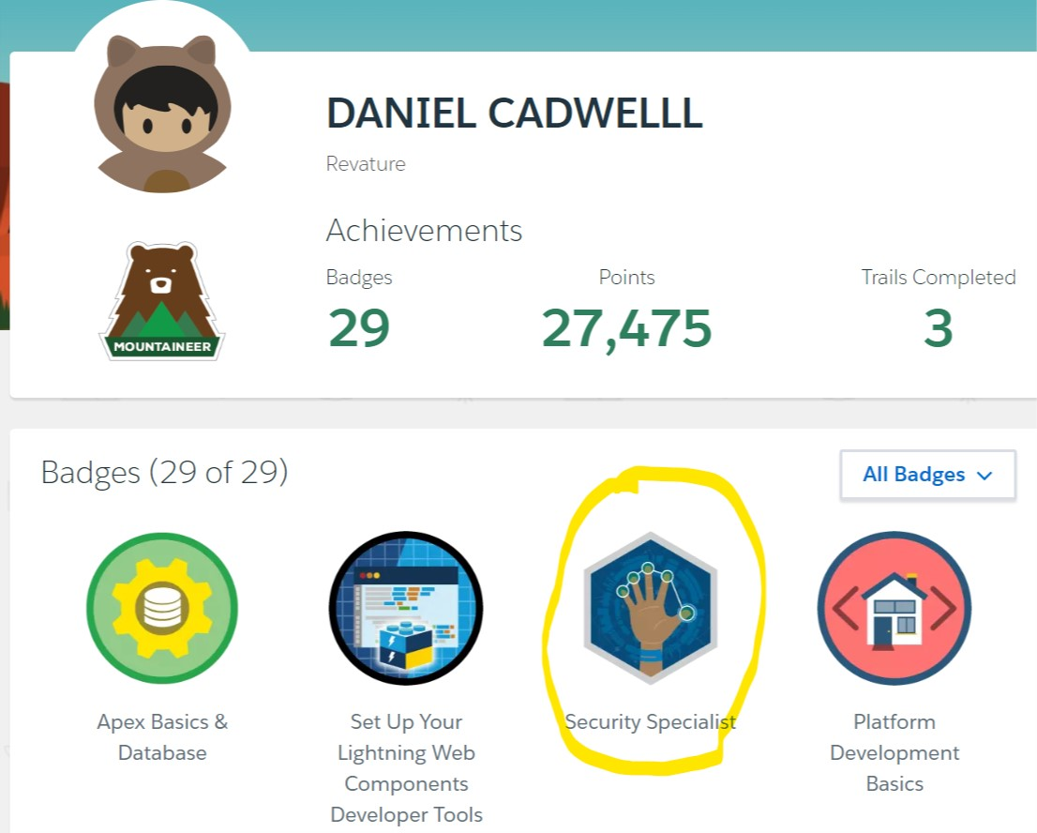
Security specialist Super Badge

Slide 4
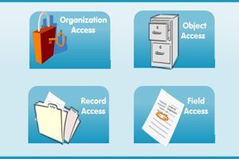
Security Settings
Password Policies:
Maximum invalid login attempts set to 3 --Enabled
Require a minimum 1 day password lifetime --Enabled
Password complexity requirement Must mix alpha and numeric characters --Enabled
User passwords expire in 30 days --Enabled
Enforce password history 3 passwords remembered --Enabled
Lockout effective period 30 Minutes --Enabled

Slide 5
Security Settings
Session Settings:
Lock sessions to the domain which they were first used --Enabled
Enable the SMS method of identity verification --Enabled
Require secure connections (HTTPS) --Enabled
Require secure connections (HTTPS) for all third-party domains --Enabled
Enforce login IP ranges on every request --Enabled
Force relog-in after Login-As-User --Enabled
Require identity verification for change of email address --Enabled
Require identity verification during two-factor authentication registration --Enabled
Session Timeout 15 Minutes --Enabled
Enable HSTS for all Sites and Communities with the default force.com
subdomain that require a secure connection (HTTPS) --Enabled

Slide 6
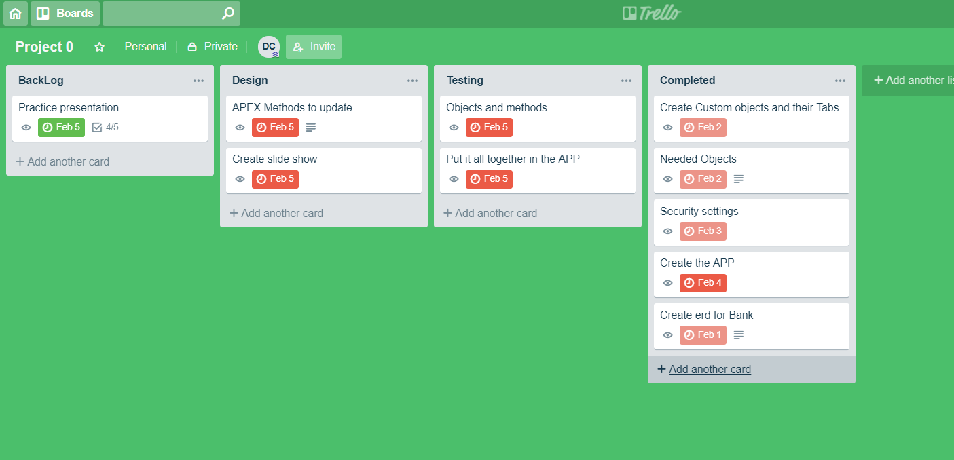
SCRUM BOARD

Slide 7
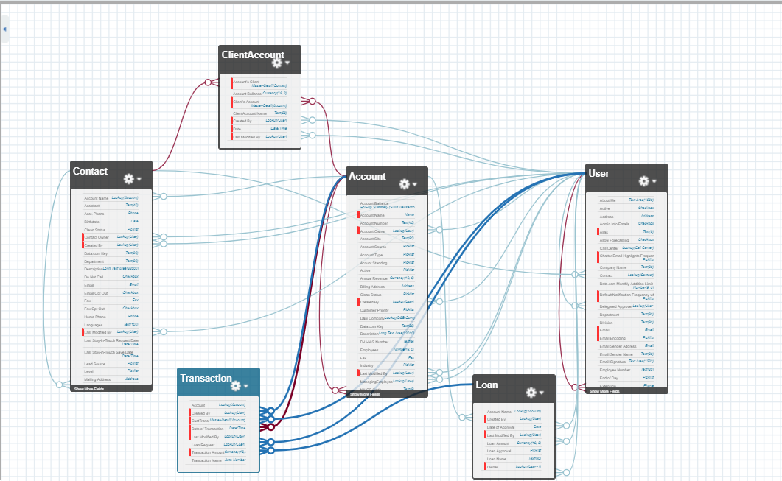

Slide 8
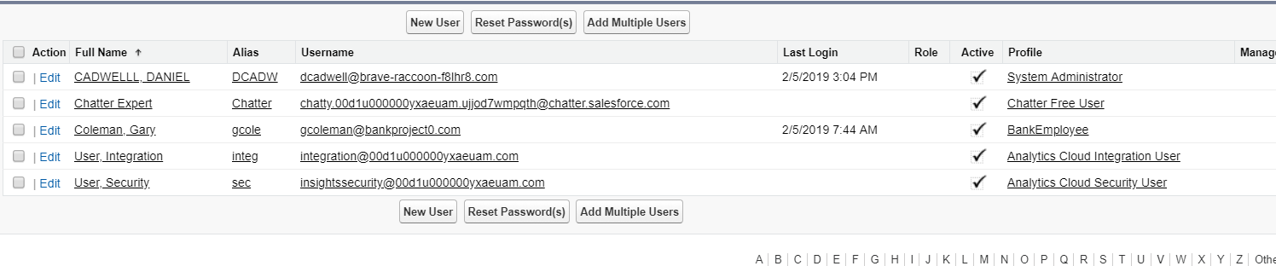




Set up User with Bank Employee Profile

Slide 9
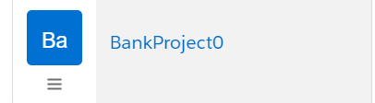
DEMO of Bank Project 0

